Slide 1
An Introduction to Alice
This is a modification of the Shark Attack Introduction to Alice written by Teddy Ward in 2013
By David Yan, Erin Taylor, and Alex Boldt
Duke University
Under the direction of Susan Rodger
June 2015
Notes:
edited
1

Slide 2
“Begin at the beginning," the King said, very gravely, "and go on till you come to the end”
- Lewis Carroll, Alice in Wonderland

Slide 3
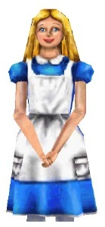
Hello! I’m Alice, and I’m
going to teach you how to use
the Alice program. With Alice, you can make your own animations,
using tons of different
characters.

Slide 4
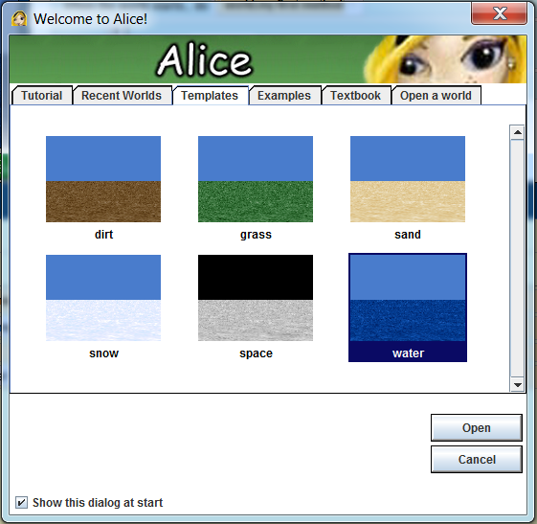
Part 1: Creating a Scene
Our first step is to choose a background.
When you open Alice, a box will pop up that has six different choices of background. It looks like the box to the right.
Select the water background, because our world will be on an island.
Click on water and then click Open.

Slide 5
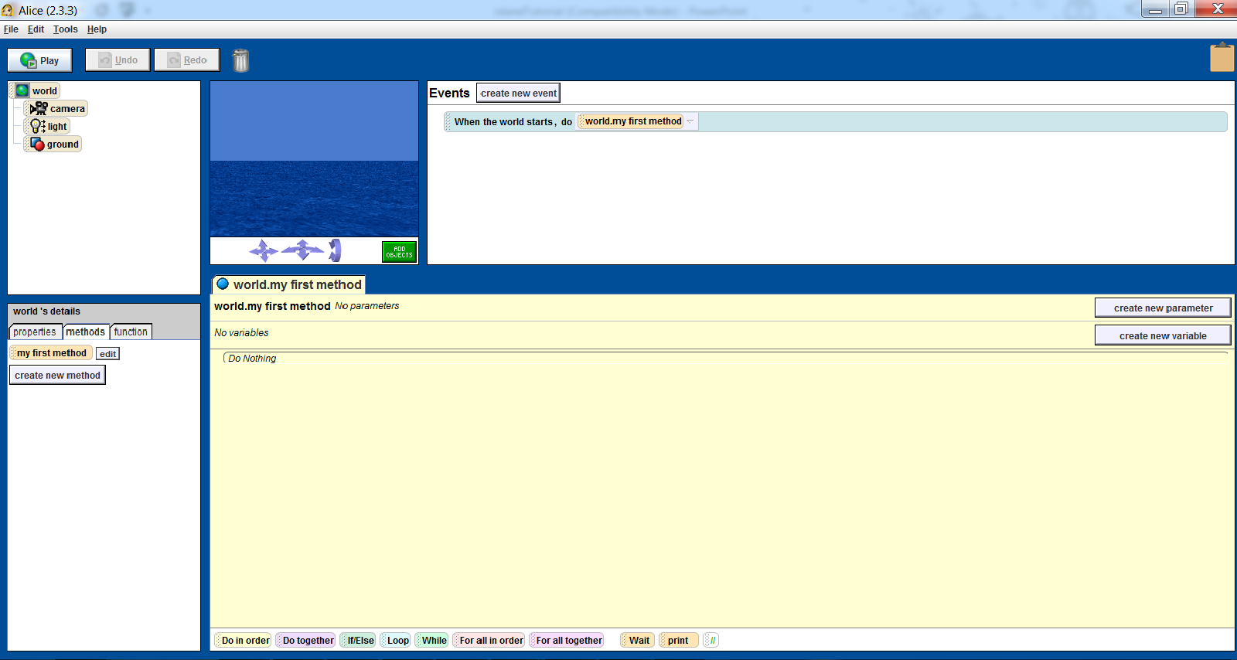
After you click Open, your screen will look like this:

Slide 6
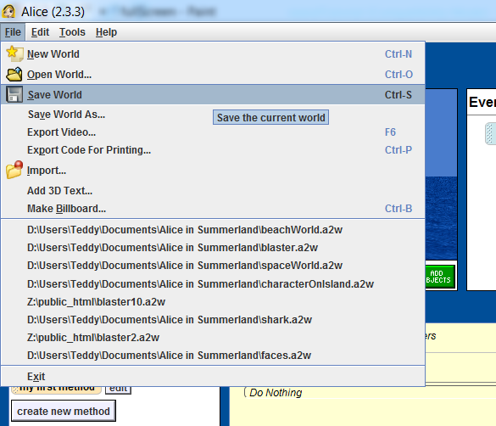
Saving your world
Before we do anything else, let’s save our world. You should also always do this before you close out of Alice.
Click on File at the
top left-hand corner
of your screen, and
then click on
Save World.

Slide 7
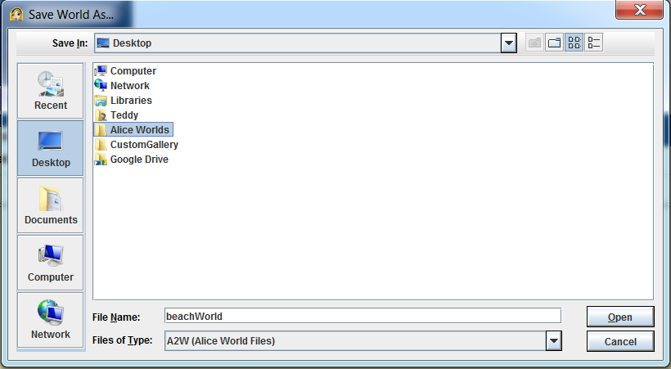
Saving your world
In the box that pops up, name your world island, and save it in a place that you will be able to find again, such as in a folder on your Desktop.

Slide 8
Saving your world
Also, while you’re working on your Alice world, this box will pop up about every 15 minutes.
You should always click Save right now. This way, if Alice crashes, or if your computer crashes, you will have backups of your world and will not lose all of your work!

Slide 9
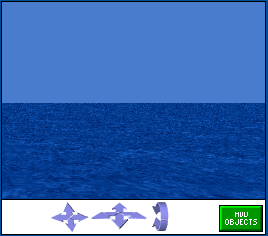
The Viewer
The viewer lets you view what your world looks like:
The arrows move the camera. DO NOT touch them for now as it’s hard to get the camera back to the original camera view

Slide 10
Adding objects to your world
Now, we will add some objects to the world.
Just below the picture of your empty water world, there is a small green button that says Add Objects.
Click on this button.

Slide 11
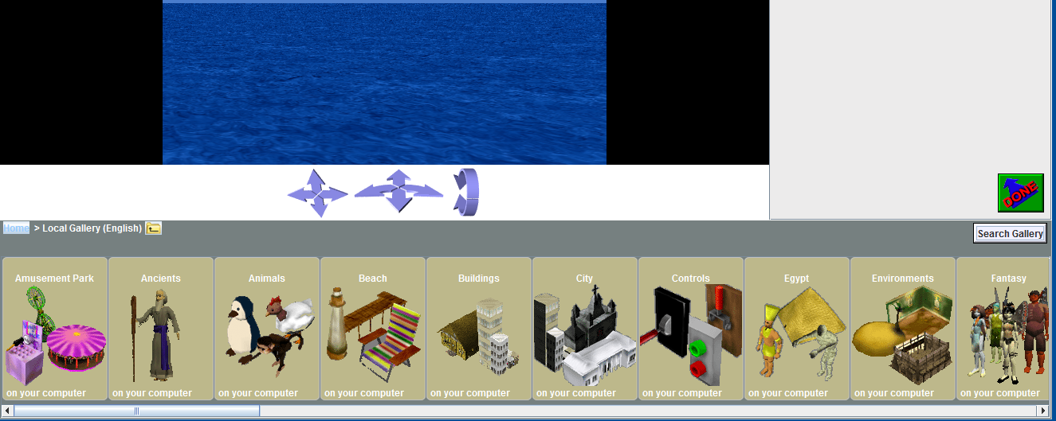
Adding objects to your world
A new screen will appear, on which there is a large selection of objects below the water screen that you can add into your world. This is called the Local Gallery. Each folder of objects in the gallery has a different theme.

Slide 12
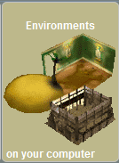
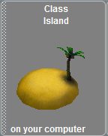
Adding objects to your world
Find the Environments folder in the gallery – you may have to scroll to the right a bit.
Scroll to the right again until you see the Island.
Click on the Island.
On the box that pops up, click Add instance to world.
The island will appear in the center of the ocean screen.

Slide 13
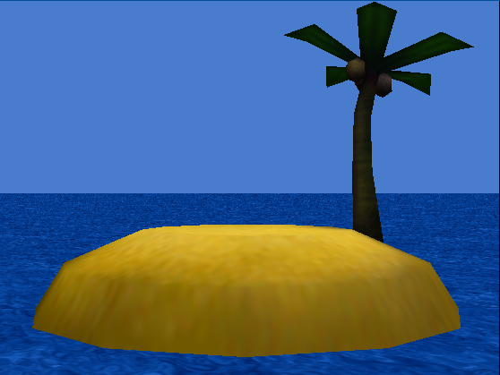
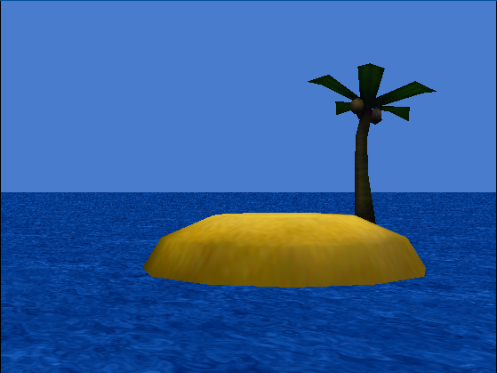
Adding objects to your world
The island will take up most of your viewer, which will cause problems when we want to add more objects in a minute
To fix this, click and drag the island around the viewer until it looks like the picture on the left

Slide 14
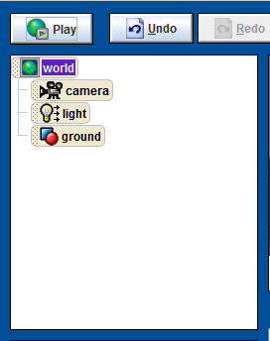
The Undo button is your friend!
What if you make a mistake, like accidentally clicking on the ocean and moving it? Or what if your island “jumps” offscreen?
You can click on the Undo button above the object tree to undo the last thing you did.
Use this button whenever you mess up, or want to get rid of something you just did.

Slide 15
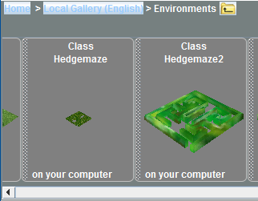
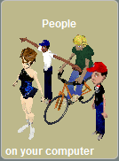
Adding a character to your world
Anyway, we’re going to add a person to our world now. Click Local Gallery above the pictures of objects to go back to the main gallery of objects.
Scroll to the right until you see a folder called people. Click on it.

Slide 16
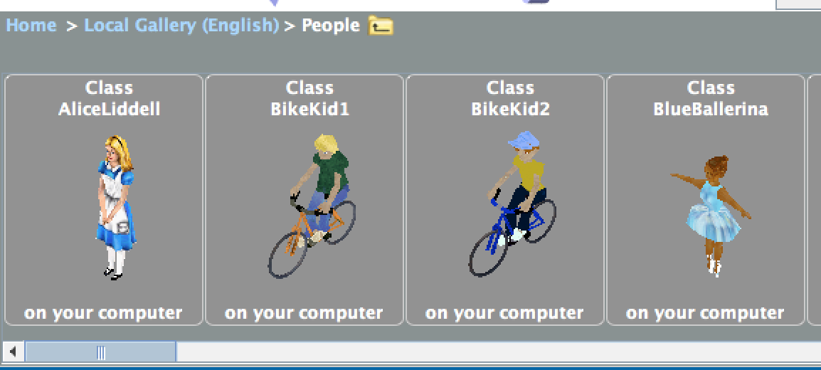
Adding a character to your world
Click your favorite person from the gallery and then click add instance to world.
Don’t spend too long choosing a person!

Slide 17
Positioning the objects
Click and drag your character into the middle of the island as shown. We’ll get him/her unstuck from the sand in a second.

Slide 18
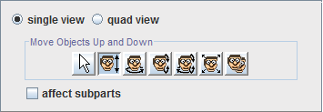
Positioning the objects
Look at the right side of your screen.
There is a group of buttons with faces on them that are used to position objects.
We want to have our person stand on the island, so click Move objects up and down (the 2nd one)
Click on your character, hold, and move your mouse up until his/her feet just touch the sand.
Bonus: move the island down into the water a little bit (move the character down again, too)

Slide 19
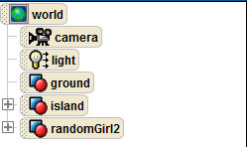
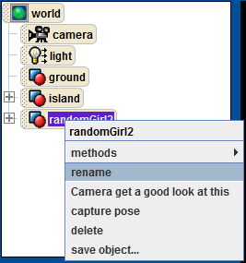
The Object Tree
When you add objects to your world, they will appear in a list on the left of your screen, called the Object Tree.
You should see both your island and your character there
If you want, right click on your character’s name, select rename, and type any name you want. I renamed mine “heroine.”

Slide 20
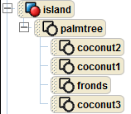
Object Parts
Some objects have parts.
For example, if you click on the plus mark next to the island in your object tree, you’ll see that the palm tree and its fronds and coconuts are all objects in your world
These are fixed in position, unless you move them with methods.

Slide 21
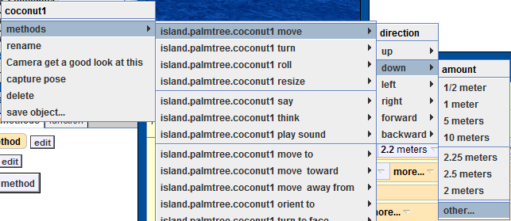
Object Parts
Right click on coconut1, choose methods, move, down, other…, and then a calculator will pop up for input.

Slide 22
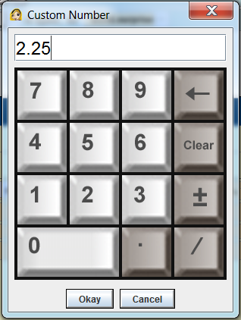
Object Parts
Type 2.25 into the calculator, and when you press okay one of the coconuts will fall to the ground.
Turning, rotating, and moving object parts is a good way to make more complex animations look more realistic!
Note: “move” may detach a part from its object but “turn” and “roll” may move parts without detaching them

Slide 23
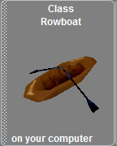
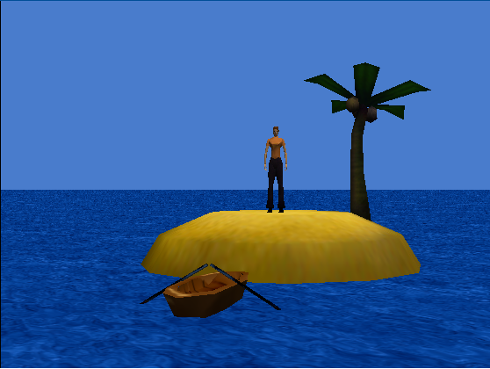
Adding objects to your world
Now return to the Local Gallery.
Scroll over to the Vehicles folder and click on it.
Scroll over to Rowboat and add that to your world.
Your world should look like this:

Slide 24
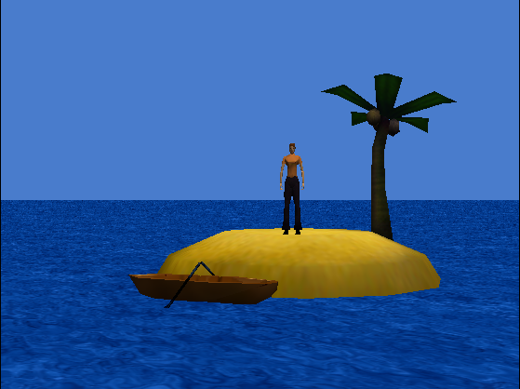
Positioning the objects
Now move the rowboat to the front left of the island using the first three buttons in that group on the top right
Click Move objects freely (the 1st one) to move it around
Click Move objects up and down (the 2nd one) to lower it into the water
Click Turn objects left and right (the 3rd one) to align it with the shore

Slide 25
Nice job setting up
the scene! Now we’re going to
learn about the camera!
(If you have extra time, add more scenery!
Use the Ocean folder in the local gallery to
add shells, fish, etc. Don’t add a shark just yet, though ☺ )

Slide 26
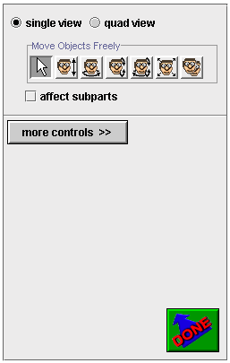
Part 2: The Camera
A Dummy camera is like a camera tripod – it saves the location of your camera view. This way, if you move your camera around, you can always get back to a certain position by moving to a dummy camera location.
Look to the right side of your screen, and find a gray button under your object positioning buttons labeled more controls

Slide 27
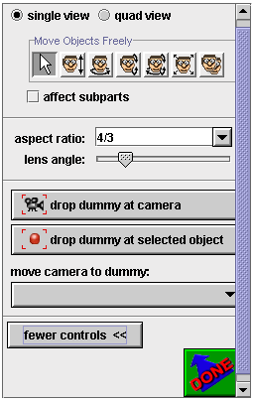
The Dummy Camera
More buttons will appear after you click more controls.
Click on the button that says drop dummy at camera. It will seem like nothing happens, but don’t worry, and only click the button one time.
Notes:
27

Slide 28
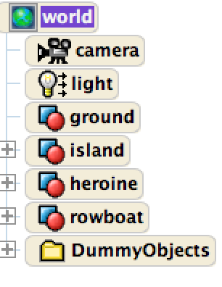
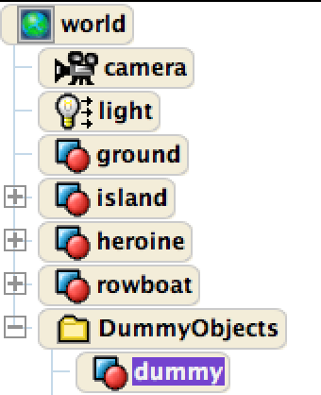
The Dummy Camera
Once you have clicked this button, a folder will appear on your object tree labeled Dummy Objects.
If you click on the plus sign next to the Dummy Objects folder, a list of your dummy camera positions will appear.
Right now, there is only one position, called dummy.

Slide 29
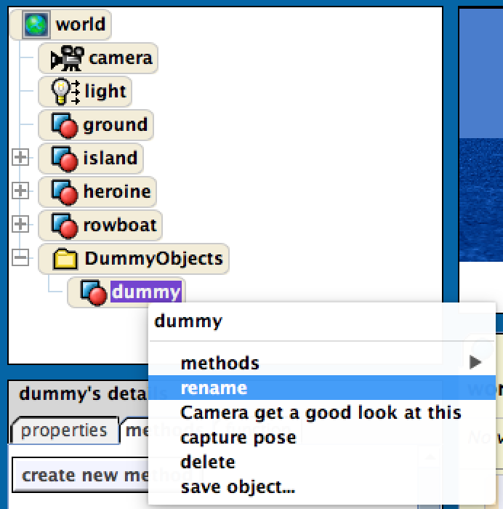
The Dummy Camera
Whenever you add a dummy camera position, you should rename it so that you know which position it is.
Right click on dummy in the object tree, and then choose rename. Type in STARTview.
Similarly, change the folder name Dummy Objects to CameraViews
You should add a dummy at your starting camera position is whenever you start a new Alice world.

Slide 30
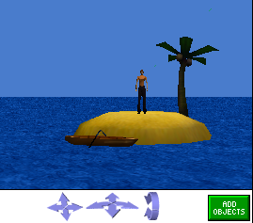
Moving the Camera
Now that we have a dummy camera set up, we can move the camera freely without losing our place.
There are three sets of arrows beneath the scene that move the camera.

Slide 31
Moving the Camera
The first set moves the camera up, down, left, and right.
The second set moves it forward and backward and turns it from left to right.
The last set rotates the camera up and down.

Slide 32
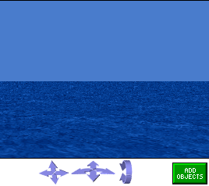
Moving the Camera
Click and hold the left arrow in the second group to turn the camera left until the island is out of the picture
Dragging your mouse farther from the arrows moves the camera faster
Be sure not to move the camera too far up or down

Slide 33
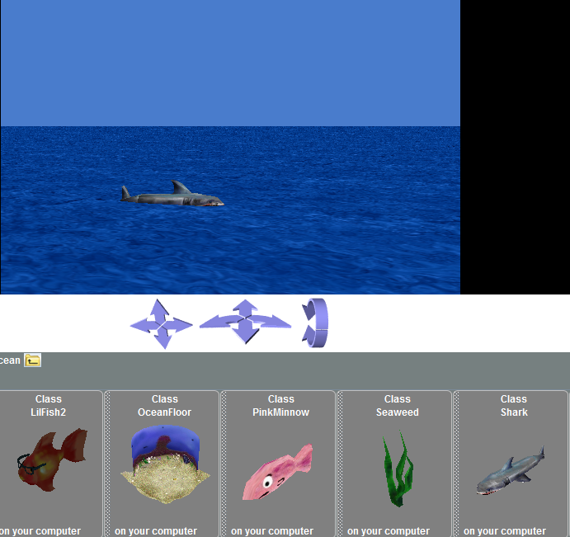
The plot thickens…
Click Add Objects, and navigate to the “Ocean” gallery
Click and drag a shark up to the window to add it to this part of the world

Slide 34
The plot thickens…
Move the shark using the positional buttons so that it’s half in the water and roughly facing the island
Click more controls, then drop dummy at camera so that we have this view saved
Rename this dummy camera “SHARKview” in the object tree

Slide 35
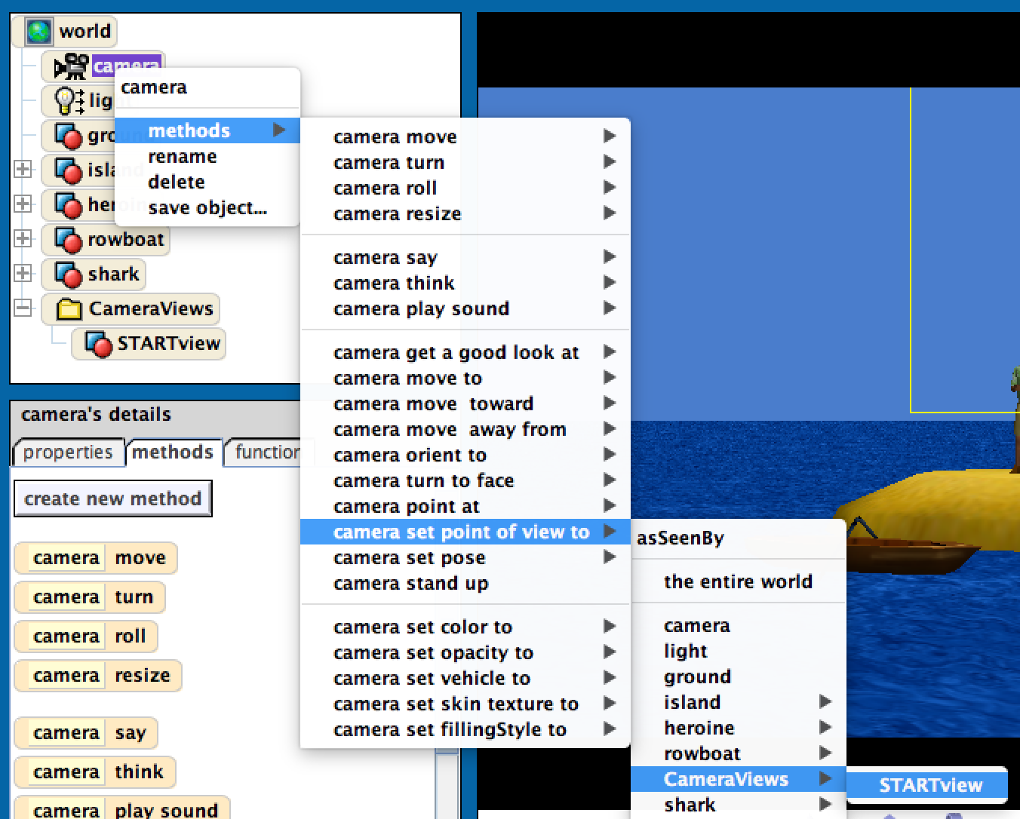
Moving the Camera
To restore the camera, right click on camera in the object tree
On the menu that pops up, choose methods, then camera set point of view to, then CameraViews, then STARTview.

Slide 36
Finishing Setup
Now just click Done (in green) towards the bottom right!

Slide 37
Now that we
are done setting up our camera,
we can start to animate the characters
in the world!

Slide 38
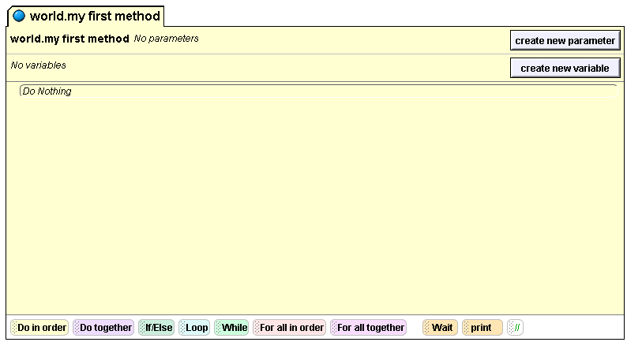
Part 3: Methods
The large beige rectangle in the center of your screen is called the Method Editor. Right now, it is blank.

Slide 39
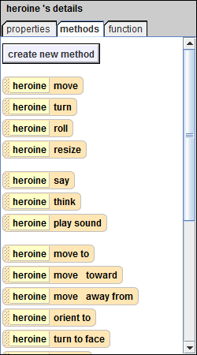
Methods
The method editor is where you can make your characters do things.
Your characters already know how to do certain things.
These are some of the things that your character already knows how to do. To find this list, click on your character’s name in the object tree. Then look below the object tree at the box that says details, and click on the methods tab. This list will appear.

Slide 40
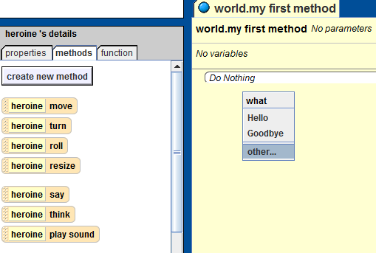
Methods
To program your character to do something, click on one of these methods, hold down your mouse, and drag and drop it into your method editor. Let’s try dragging in say to start. Select other… to be able to choose what we want he/she to say. Then type something like “Hey! Welcome to my island!” and press okay.
Becomes…

Slide 41
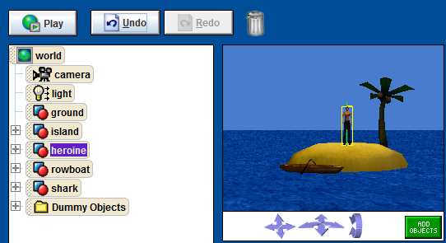
Methods
Now press the Play button in the upper left-hand corner of the screen to watch your AMAZING program in action!!!!!
Okay. That was pretty boring. Let’s spice things up by teaching our character to do a backflip
Notice that there is no method for backflip created yet!

Slide 42
Methods
To teach your character new things, you can combine methods that he/she already knows into new methods.
Make sure you have clicked on your character in the object tree. Then, go to the methods for your character and click create new method.

Slide 43
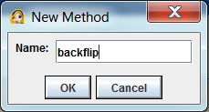
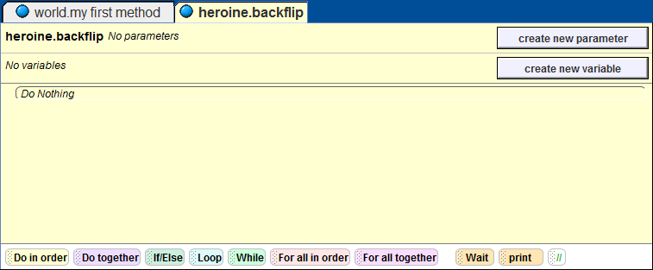
Backflip Method
In the box that pops up, type backflip, then click OK.
You should see a new tab appear in your method editor called heroine.backflip (heroine will be replaced by your character’s name). This is the space where you will program the backflip.

Slide 44
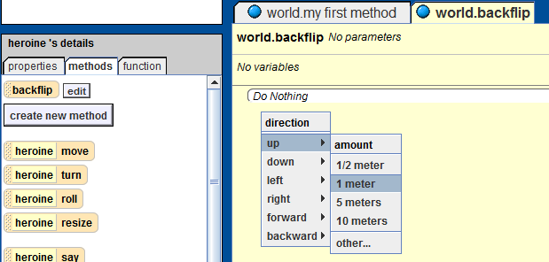
Backflip Method
Drag heroine move into the method editor
Select up, then 1 meter
Drag another move below this, but this time select down then 1 meter.

Slide 45
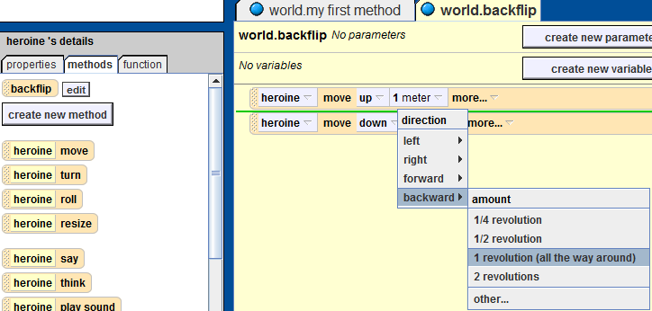
Backflip Method
To finish the flip, drag in turn between the two movements (a green line should appear when you’re between them)
Choose backward, then 1 revolution (all the way around)
Now your character will move up, flip, and then move down

Slide 46
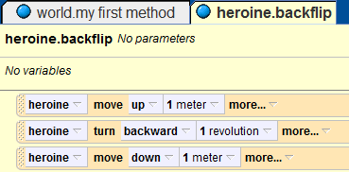
Backflip Method
Your code should look like this:

Slide 47
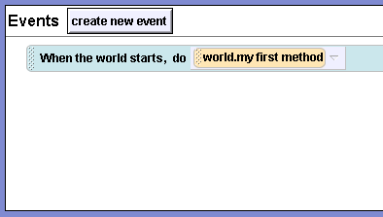
Events
Now that we have written a method, we’ll use an event to see it in action.
The event editor is found in the top right-hand corner of your screen.
Events are used to tell our program when it should call our methods.
This is the event editor

Slide 48
Events
You’ll see that when the world starts (when you press Play), your world does world.my first method.
Click where it says world.my first method, and change it to your character > backflip.
Now when you press in the upper left, your character will do a backflip!
Notes:
edited
48

Slide 49
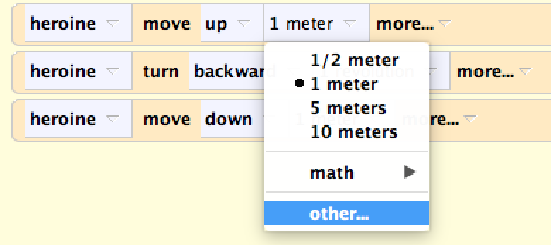
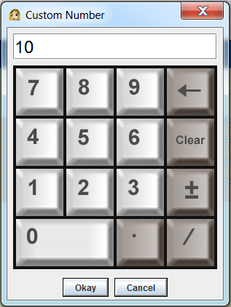
Backflip Method
Depending on how tall your character is, he/she might have hit his/her head on the ground. To fix this, click 1 meter next in the move up command, and choose other… Try typing 2 in the calculator that comes up to start.
Be sure to adjust the move down command, too.
Notes:
edited
49

Slide 50
Backflip Method
Finally, to make have our character say “Hey! Welcome to my island!” and then do the backflip, select the world.my first method tab again
Drag in backflip from your character’s list of methods.

Slide 51
Testing!
Now change your “When the world starts” event in the event editor back to world.my first method.
We do all this because testing one method at a time will be a really good time-saving habit later.
Now just press to run the whole thing!

Slide 52
Part 4: Add a Surprise
First, drag in a shark say to the bottom of world.my first method. Select other, then type “S” in the box that comes up
Click more… next to this in your method editor, a menu of properties will appear. Select duration, and change it to 2 seconds so people have more time to read the message
Then, drag in a heroine say to the bottom of world.my first method. Select other, then type “What is S?” Change the duration to 2 seconds
Your method will look like this:
Notes:
Edited-make 2 later
52

Slide 53
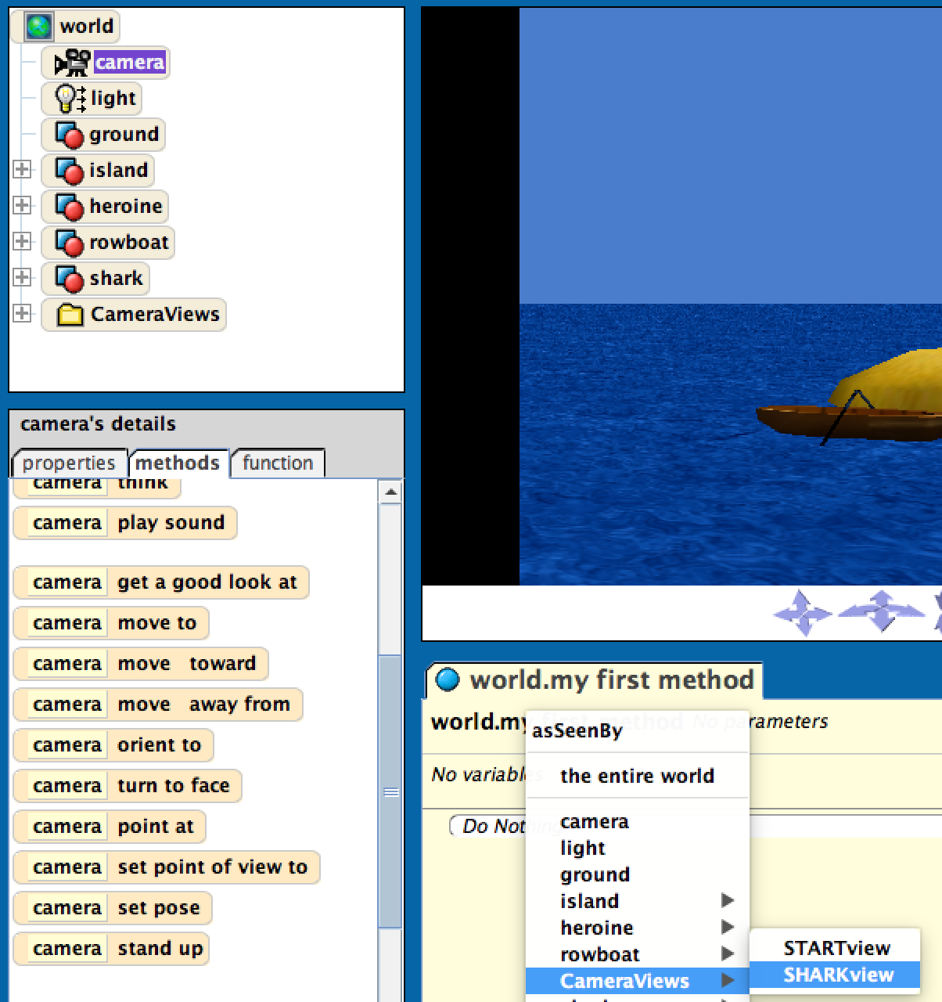
Changing Camera Views
S also stands for “Shark,” so we’ll have the camera get a look at the shark.
To get the camera to change position while your program runs, we have to use its methods.
Select camera in the object tree, then drag in its set point of view to method.
Select CameraViews > SHARKview on the menu that comes up.

Slide 54
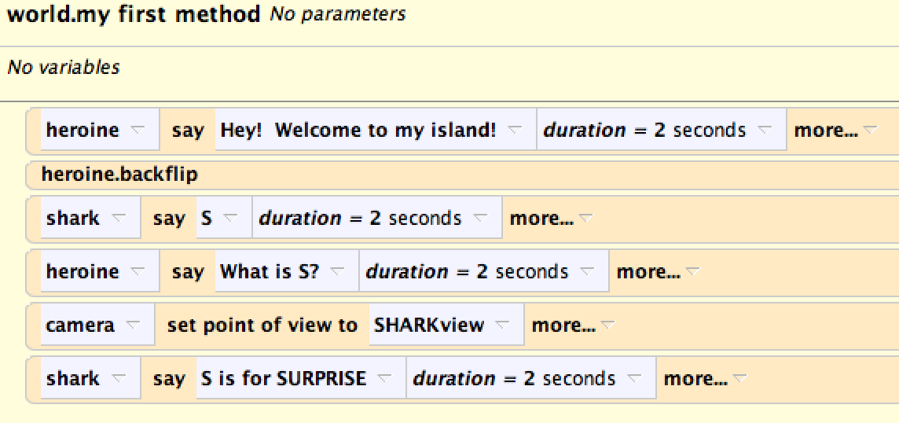
Adding a Surprise
Your world.my first method should look like this:
Notes:
edited
54

Slide 55
Adding a Surprise
Drag in a shark say to the bottom of world.my first method. Select other, then type “S is for SURPRISE” in the box that comes up
Click more… next to this in your method editor, a menu of properties will appear. Select duration, and change it to 2 seconds Your method should look like this:
Notes:
edited
55

Slide 56
Moving Camera Views
Now we want to move the camera back to the starting position.
Select camera in the object tree, then drag in its set point of view to method.
Select CameraViews > STARTView on the menu that comes up.
The line of code is shown:
Notes:
inserted
56

Slide 57
Adding a Surprise
Then select shark in the object tree, drag in a move towards method, and choose 2 meters > rowboat > the entire rowboat
This will have the shark move 2 meters towards your boat.
Notes:
Edited
57

Slide 58
Adding a Surprise
Change the distance of your move towards method to how far away you think you estimate your shark is from the rowboat.
To do so, click amount=2 meters, other, then type in your guess on the calculator
Set the duration (under more…) of your move towards method to 5 seconds so the user has time to react to the shark

Slide 59
Adding a Surprise
Your method should look like this:
Notes:
edited
59

Slide 60
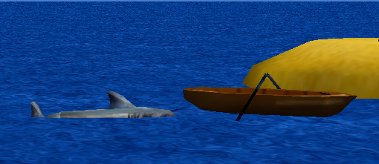
Test
Now press Play to test your world!
Your shark should stop just in front of the boat, but because we just guessed his distance to the boat, he probably won’t. Play with the distance in your move toward call until your shark ends up like this:
For me, the distance was 4 meters.
Notes:
edited
60

Slide 61
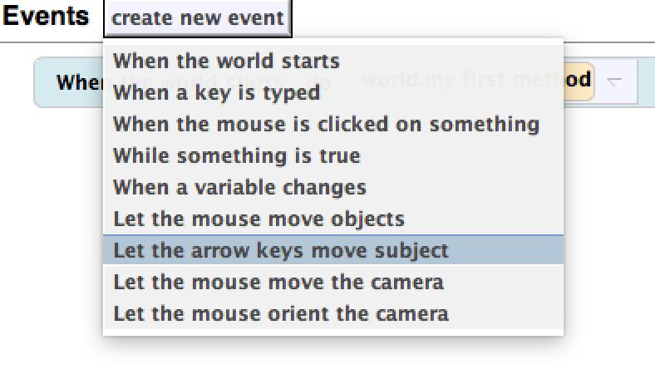
Moving the Boat
We’d like to move the rowboat with the arrow keys
Click create new event in the event editor (top right)
Choose Let the arrow keys move subject
Change camera to rowboat > the entire rowboat
Notes:
edited
61

Slide 62
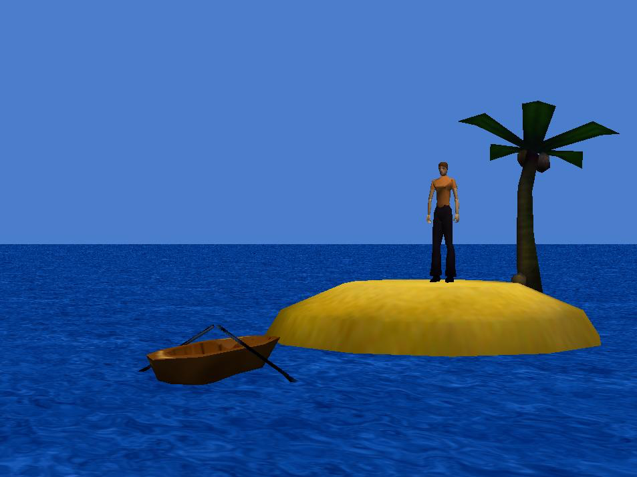
Moving the Boat
Try running the animation now and moving the boat with the arrow keys
You will see that it moves by itself
We’d like to move the boat with the Heroine inside, so we’re going to create a GetInBoat method to accomplish that

Slide 63
Part 5: GetInBoat Method (Using Vehicles)
While the shark can’t exactly walk on land and attack our character, we’re going to have him/her escape in the rowboat anyway
Click on your character in the object tree, then create a new method. Call it getInBoat

Slide 64
Testing the getInBoat method
To test the getInBoat method, change the event “When the world starts” to call the heroine.getInBoat method
This way we can test only the getInBoat method as we develop it.

Slide 65
GetInBoat Method
Now click on the properties tab in the details pane (where the methods are)
The properties pane lets you change various things about your object.
Later, you’ll be able to make your character red, radioactive, or invisible
For now, look at the vehicle property

Slide 66
GetInBoat Method
Drag the vehicle property into the method editor (make sure the new getInBoat tab is selected) and select rowboat > the entire rowboat.
Now when the rowboat moves, your character will move with it; your character is riding the boat.

Slide 67
GetInBoat Method
Your method should look like this:

Slide 68
Moving the Boat
Try running the animation again and moving the boat
You will see that the heroine is now moving with the boat but not in it.
You should notice that the boat can go off the screen.
We would also like the camera to move with the boat as well.

Slide 69
Setting the Camera’s Vehicle
To fix this, repeat the steps from before to set the camera’s vehicle to the rowboat
Now your camera will follow the boat as it moves around
Your method should look like this:

Slide 70
Moving the Boat
Play your world! You should notice another problem:
Your world may look like this, so now we need to place the heroine inside the boat

Slide 71
Editing GetInBoat
Drag in a move to, and select rowboat > the entire rowboat (to move your character to the boat)
Drag in an orient to (scroll down), and select rowboat > the entire rowboat (to face the front of the boat)

Slide 72
Do Together
Now, from the bottom of the screen, where there are several advanced (but common) coding constructs, drag in a do together.
Normally, actions in Alice take place in order. One line of code will run, then the next one.
By putting multiple methods inside of a do together, those methods can happen at the same time

Slide 73
Do Together
Now we can put all of our methods into the Do Together block.
Order does not matter, since they will all run at the same time

Slide 74
Editing GetInBoat
Drag in a say above the do together, and have your character say something like “Oh no! Use the arrow keys to help me escape!” so that the person using your world knows what to do.

Slide 75
GetInBoat
Finally, drag in a move below the do together, select down > ½ meter.
This will make your character sit more realistically in the boat. The exact distance (or even direction!) may be different for different characters – experiment!

Slide 76
Back to world.my first method
Go back to the event space, and change the “when the world first starts” event back to calling the world.my first method
We will now be editing world.my first method

Slide 77
Calling GetInBoat
Select your character in the object tree, and drag your new method, getInBoat into your world.my first method. It should look like this:
Notes:
edited
77
Idk

Slide 78
Do together
Now, from the bottom of the screen drag in a do together.
Notes:
inserted
78

Slide 79
Do Together
Drag our last two lines into the do together
Otherwise, our character would wait until AFTER the shark attacked to get in the boat
Notes:
edited
79

Slide 80
Updated Method
Your world.my first method should look like this:
Notes:
edited
80

Slide 81
Test
Play your world! Everything should be working correctly

Slide 82
callForHelp method
Now we want to let our heroine call for help
Click on your character in the object tree, then create a new method. Call it “callForHelp”
In the method just drag in a heroine say, select other, and type “HELP”
Your method should look like this:
Notes:
inserted
82

Slide 83
callForHelp method
In addition to screaming “Help!” we also want our heroine to wave her arm at the same time.
To have our heroine do these things at the same time, drag in a “Do Together” block.

Slide 84
callForHelp method
Now we want to access our heroine’s shoulder in order to make her raise it.
In the object tree, click on the plus sign beside the heroine and select the left shoulder
Note: Our arm movement uses the “leftShoulder” object for our character but this can change depending on which character you choose. For many, it might be called “leftArm.”

Slide 85
callForHelp Method
Now we want to add code so that her arm moves up and then back down.
To do this select the left shoulder, then select the turn method and turn the heroine’s left shoulder ½ revolution.

Slide 86
callForHelp Method
Now that we have moved our heroine’s arm up, we must move it back down.
Follow the same steps from the previous slide, except turn her shoulder forward this time. The code should be as follows:

Slide 87
callForHelp method
Run the callForHelp method by changing the “When the world starts” event to have it run heroine.callForHelp
Run your world. Does it work?

Slide 88
callForHelp method
Notice that your character only says “HELP!” and doesn’t raise his/her hands
Why not?
Notice that the two arm movements are in opposite directions and are both in a “do together” block
Therefore they cancel each other out!!
How do we fix this?

Slide 89
Fixing callForHelp method
We need the arm movements done in order, BUT at the same time as when she yells “HELP!”
To do this, we need the arm movements in a “do in order” block nested inside the “do together block” with the “HELP!” say method.

Slide 90
Fixing callForHelpMethod
Next, we drag in the arm movement methods into the “do in order” block.
Remember, we want the arms to go backwards first, and then forwards, so put them in that order.

Slide 91
Test callForHelp method
Run your world now
The heroine should now put her arm up while yelling “HELP!”, then put her arm back down

Slide 92
Finishing callForHelp method
We need to change the “when the world first starts” event back to call the world.my First method
Do as follows:

Slide 93
Adding an Event
We want our heroine to be able to call for help on command.
To do this we are going to create a new event.
Select create new event in the event editor (top right), then choose When a key is typed.
Notes:
inserted
93

Slide 94
Adding an Event
Change any key to letters > H and Nothing to callForHelp.
Note that this will call the “callForHelp” method ANYTIME you press H, but your users will only know to do so when you instruct them.
Notes:
inserted
94

Slide 95
Calling the Event
To let the user know that they can press H to make the heroine call for help add in a Heroine say in the world.my first method
Here is the call:
Now when you run the world, you should be able to make the heroine call for help whenever you press H

Slide 96
Circling
Right now, the shark just sits by the beach like a chump after you ride your boat away
We’ll have it swim circles around the island instead to keep things exciting

Slide 97
Circling
Open up world.my first method via the object tree.
Click on shark in the object tree, and drag shark think into the method editor. Select other, and type in something like “Rats. I’ll just have to wait here.”
Notes:
Edited
97

Slide 98
Circling
Drag in shark turn, then select left > other > 10 revolutions.
Under more… choose asSeenBy > island > the entire island.
This will make the shark turn around the island instead of just spinning in circles
Change the duration to 50 seconds

Slide 99
Circling
Play your world.
If the shark circles very close to the island, move your boat offshore a bit in the viewer (why?)
If the shark doesn’t circle the island, copy the code below (note your mistakes, though!)
Notes:
edited
99

Slide 100
Comments
Now note the double slash on the far right side of the line of coding constructs at the bottom of your editor.
This icon lets you add comments to your code that won’t affect the program when it actually runs.
Drag and drop one anywhere in your code and write an explanation for the line below it. An example:

Slide 101
Notes for later
If you later want to unglue your character from the rowboat, set the vehicle property of your character from rowboat back to world (be sure to do the same thing for camera!)

Slide 102
Finished world.my first method

Slide 103
Congratulations! You have just
made your first Alice world. There are many more things that you can do with
Alice, so keep exploring it!

Slide 104
Extensions (in order of awesomeness)
Make both of the heroine’s arms move up and down when she calls for help
Add more scenery.
Make the coconuts fall from the tree when you press spacebar.
Make your boat your favorite color (hint: you’ll have to change the color AND texture).
Figure out how to change the weather; make a foggy sunset.
Check out the “functions” tab (next to “methods” and “properties”) and do something interesting with them.
Dream up many more worlds, where magical, impossible things happen. If you ever need help, try out some more try out some more tutorials on Duke’s Alice webpage.
“Its important to have specific dreams. Dream Big. Dream without fear.”
- Randy Pausch, creator of Alice

